Slide 1
Policies, Procedures, and People
Dr. William Hutton, CISSP
Washington State University

Slide 2
Overview
Environmental Controls
Social Engineering
Legislative and Organizational Policies

Slide 3
Environmental Controls

Slide 4


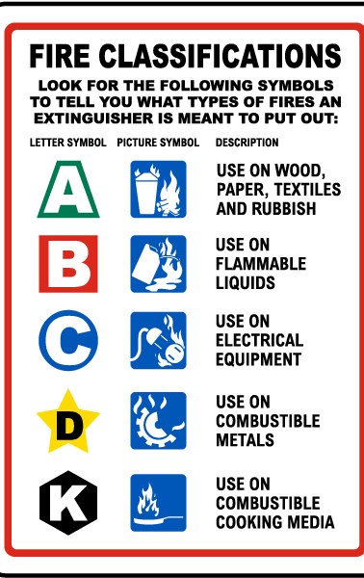

Fire Suppression
Fire Extinguishers
Class A, B, C, D, K
Sprinkler system (wet pipe)
Special hazard protection systems (dry pipe)
Halotron, FE-36, FM-200
Notes:
Fire needs three things, fuel, oxygen, and an ignition source. Take away one, and you have no fire.

Slide 5
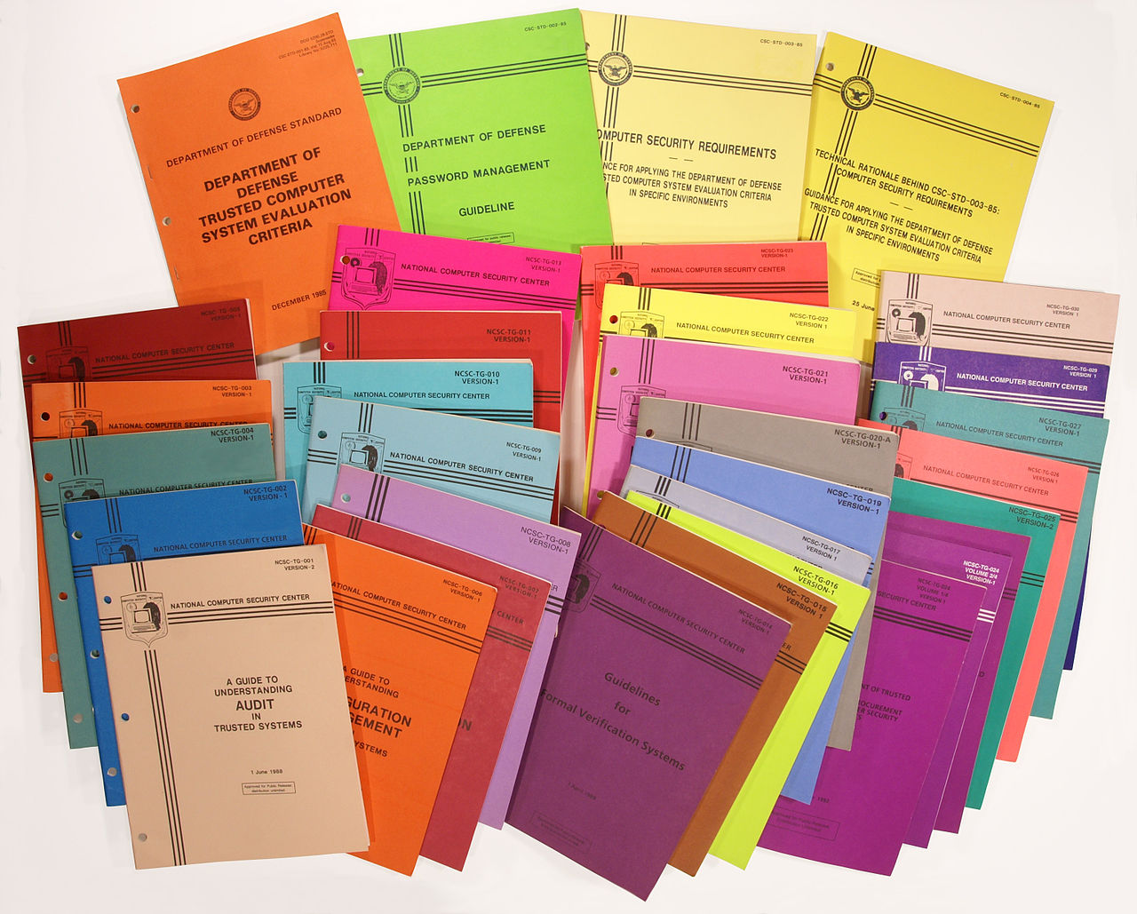
Shielding
Shielded twisted-pair (STP) cable
Plenum vs. riser cables
HVAC shielding
Faraday cage (TEMPEST)
DOD Computer Security (1980s)
https://en.wikipedia.org/wiki/Rainbow_Series
Notes:
Plenum rating is for commercial and residential spaces that use raised floors, dropped ceilings, and other “hidden” spaces that must be fire resistant.
They have a higher fire rating, and lower smoke.
Riser or “non-plenum” cables run vertical through floors or elevator shafts and must pass a vertical burn test, but standards are not as strict.
Plenum can replace riser, but riser cannot replace plenum. Plenum >> riser.
Source: https://www.wireandcableyourway.com/blog/difference-between-plenum-rated-cable-riser-rated-cable/

Slide 6
Social Engineering

Slide 7
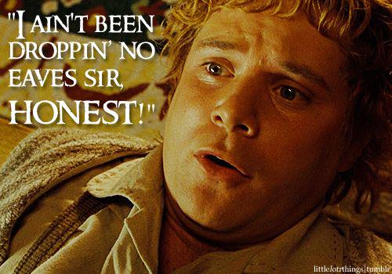
Types of Social Engineering
Pretexting
Diversion theft
Phishing
Hoaxes
Shoulder Surfing
Eavesdropping
Dumpster Diving
Baiting
Piggybacking / Tailgating
Notes:
Pretexting (lying) is a common technique in skip tracing (bounty hunting)
Baiting = “Found” USB drive in parking lot
Dumpster Diving = Old phone phreak technique (phone company)

Slide 8
Legislative and Organizational Policies

Slide 9
Acts Passed Concerning PII
Act | Acronym | Description
Privacy Act of 1974 | n/a | Establishes code of fair information practice. Governs the collection, use, and dissemination of PII by Federal agencies.
Sarbanes-Oxley | SOX | Governs disclosure of financial and accounting information (2002)
Health Insurance Portability and Accountability Act | HIPPA | Governs disclosure and protection of health information (1996)
Gramm-Leach-Bliley Act | GLB | Enables commercial banks, investment banks, securities firms, and insurance companies to consolidate. Protects against pretexting to gain access to non-public information (e.g., SSNs).
California SB 1386 | SB 1386 | Requires California businesses to immediately disclose PII breaches.
Notes:
PII = Personally Identifiable Information

Slide 10
Organizational Policies
Personnel Security
Privacy Policies
Acceptable Use
Change Management
Separation of Duties / Job Rotation
Mandatory Vacations
Due Diligence
Due Care
Due Process
User Education Awareness and Training
Notes:
Due diligence: risks are known
Due care: risks are managed (mitigated)
Due process: respect and safeguard personnel’s rights. (Protect from state and frivolous lawsuits)

Slide 11
Disposal of Computers
Recycle or donate IT equipment
3-5 year “refresh” cycle is typical
Outdated hardware
Non-productive to organization
Define what is to be disposed of.
Obtain temporary storage.
Analyze equipment
Sanitize
Check for removable media
Remove RAM, label and store
Remove HDD, sanitize and store
Reset BIOS
eRecycle or donate

Slide 12
Incident Response
Identification
Containment
Evidence Gathering
Investigation
Eradication
Recovery
Document and Monitoring
NIST SP 800-61 “Computer Security Incident Handling Guide”

